Slide 1

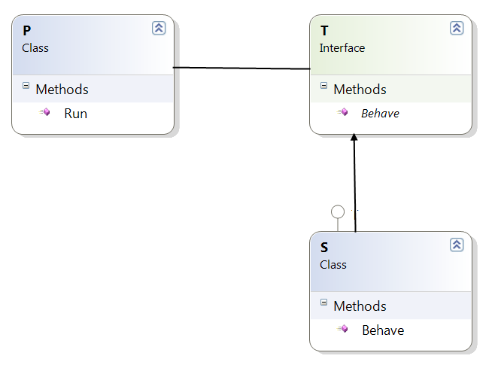
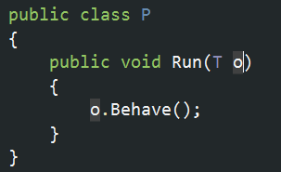
Liskov Substitution Principle
“What is wanted here is something like the following substitution property: If for each object o1 of type S there is an object o2 of type T such that for all programs P defined in terms of T, the behaviour of P is unchanged when o1 is substituted for o2 then S is a subtype of T.”

Slide 2
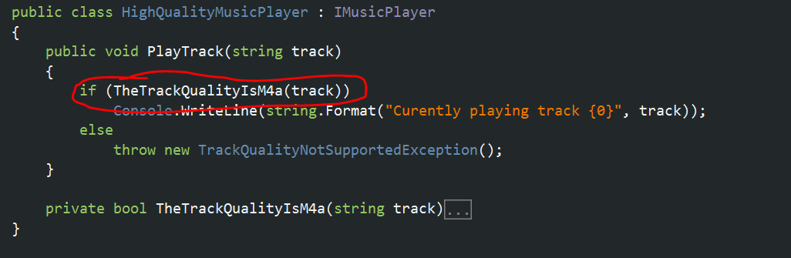
Subtypes must behave as expected
The HighQualityMusicPlayer added some unexpected behaviour...

Slide 3

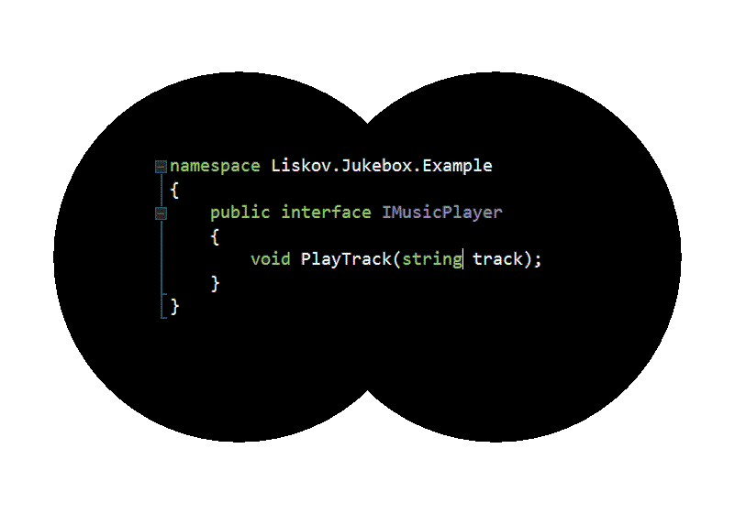
What does the Jukebox see?

Slide 4
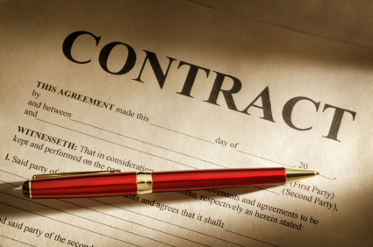
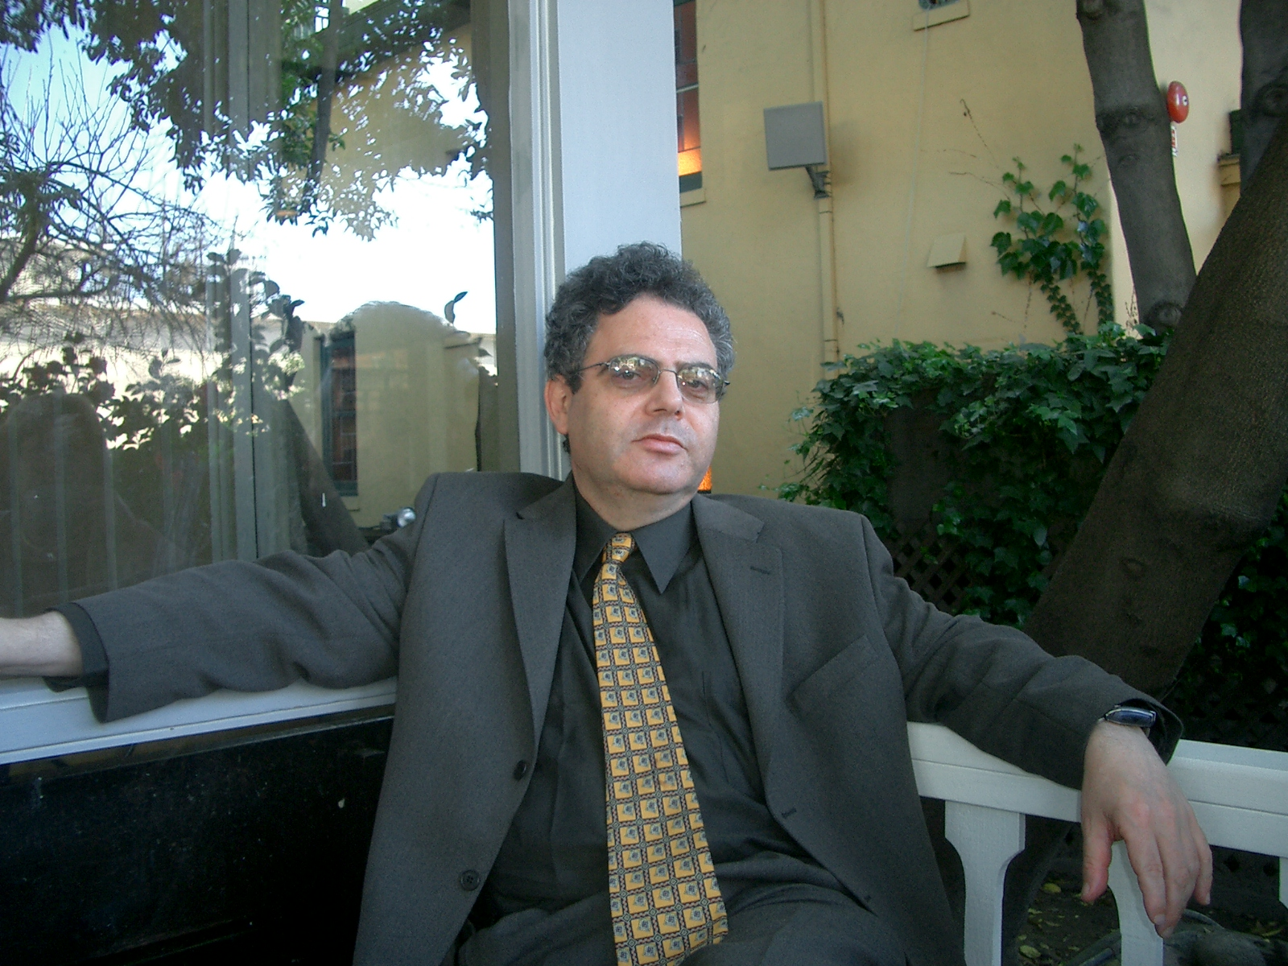
Bertie - Design by Contract
Every object has a contract
Design objects with explicit contracts
Use assertions to enforce contracts

Slide 5
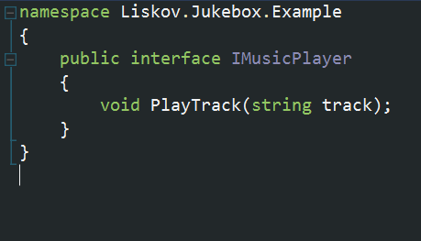
The IMusicPlayer Contract
- If you give me a track
- Then I promise to play it for you

Slide 6
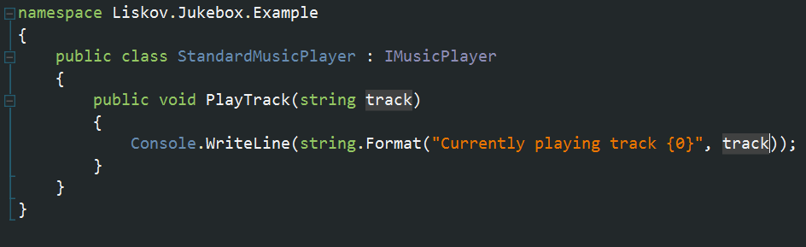
The StandardMusicPlayer
- If you give me a track
- Then I promise to play it for you

Slide 7
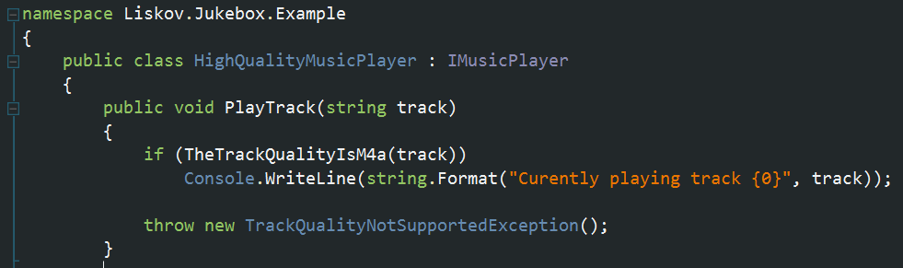
The HighQualityMusicPlayer
- If you give me a track
- And it's an m4a file
- Then I promise to play it for you
- Or throw an exception

Slide 8
Contracts and Inheritance
Pre conditions:
  Must not be strengthened
Post conditions:
  Must not be weakened

Slide 9
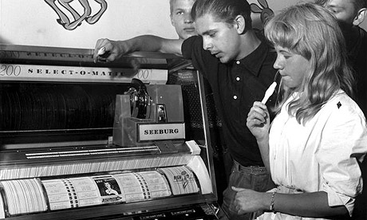
Back to the Jukebox
How can we fix this?

Slide 10
Rules for using Inheritance
Subtypes must exhibit the same implied behaviour as their base type / interface
Subtypes must not strengthen the pre conditions of their base type
Subtypes must not weaken the post conditions of their base type
Amen

